Slide 1

Electric Vehicle Seals:
Minor Project Presentation for
“DATA ANALYTICS USING TABLEAU (CUTM1023)”
Soumya Ranjan Sahoo - 220301120128
Shubham Kumar Nath - 220301120147
Subhadip Samanta - 220301120140
Rahul Kumar - 220301120133
Soumya Ranjan Sahoo - 220301120121
Under the Supervision of
Mr. Tanmay Kumar Panda
Teaching Assist, Dept. of CSE, SoET

Slide 2
Outlines:
Introduction
Dataset Overview
Project Overview
Graphs and Visualizations
Dashboard Overview
Conclusion

Slide 3
Introduction:
This project focuses on understanding the growth and patterns in the electric vehicle (EV) market. Using data on EV registrations and visualization tools like Tableau, we’ll explore trends, locations, and types of EVs being used. The goal is to find insights that can help with planning for EV infrastructure, making policies, and understanding the EV market better.
The dataset includes information on EV types, model years, and locations where they are registered. With Tableau, we’ll create easy-to-understand charts and dashboards to highlight patterns and important findings. This project helps us see where the EV market is headed and what might come next.

Slide 4
Dataset Overview:
Vehicle Type: Identifies whether the vehicle is a battery electric vehicle (BEV), plug-in hybrid electric vehicle (PHEV), or another EV type.
Model Year: Indicates the manufacturing year of each vehicle, which helps us observe the adoption trends over time.
Make and Model: Shows the brand and model of each vehicle, allowing us to identify popular EV brands and models.
Geographic Location: Includes location data, such as city or state, giving insights into regional EV adoption and distribution patterns.
Ownership Details: May contain information on individual or corporate ownership, helping to distinguish between private and commercial use.

Slide 5
Project Overviews:
This project analyzes electric vehicle (EV) adoption patterns, growth trends, and geographic distribution across different regions. Using a dataset containing details on EV registrations, we aim to gain insights into how and where EVs are being adopted and which factors might influence their popularity.

Slide 6
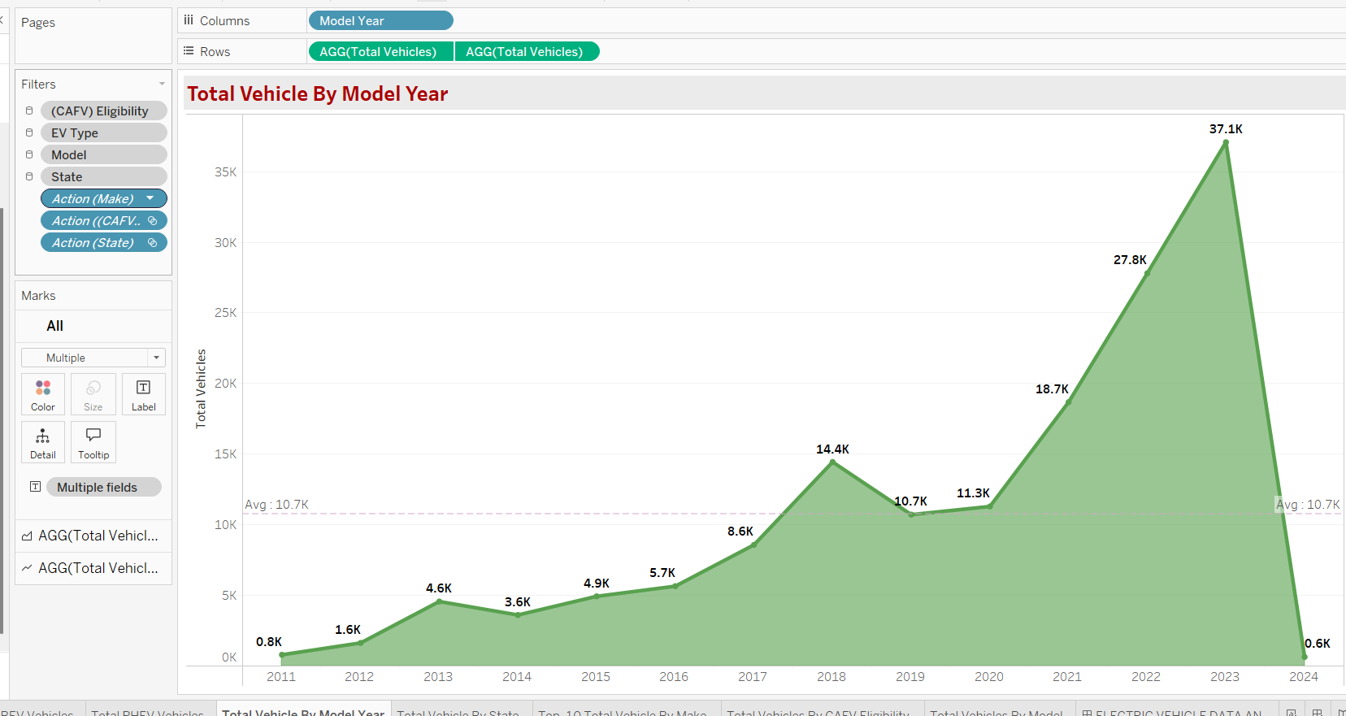
Graphs and Visualizations:
Total Vehicle By Model Year:
The graph titled "Total Vehicles by Model Year" is a visual representation of the count of vehicles across different model years. Each bar (or line point if it's a line chart) corresponds to a specific model year, with the height (or position) of each point representing the total number of vehicles registered for that year.

Slide 7
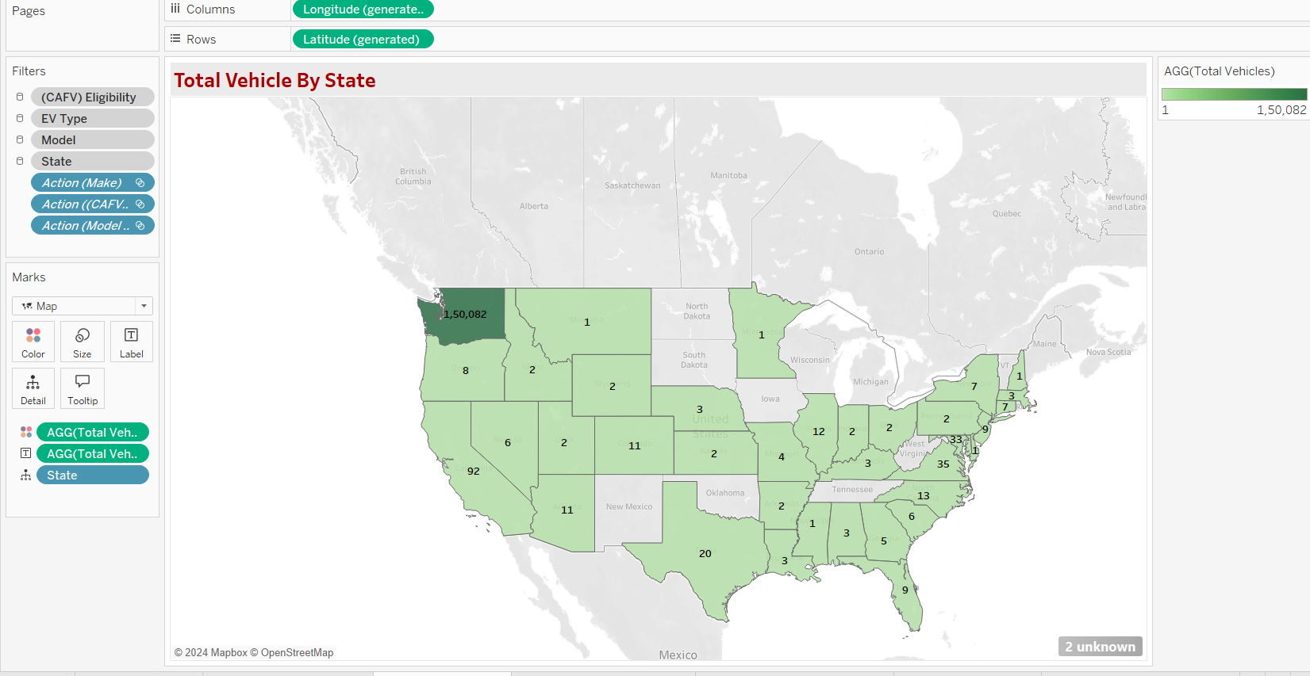
Total Vehicle by States:
This graph provides an overview of electric vehicle registrations across different states, offering insights into regional adoption patterns.

Slide 8
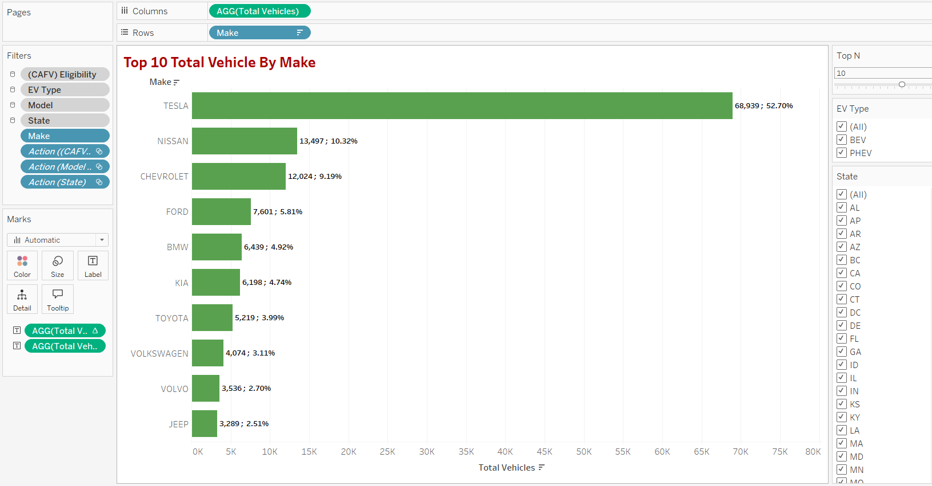
Top 10 Total Vehicle By Make
This graph highlights the top 10 electric vehicle makes with the highest registrations, giving us a clear picture of brand popularity and market share in the electric vehicle sector.

Slide 9
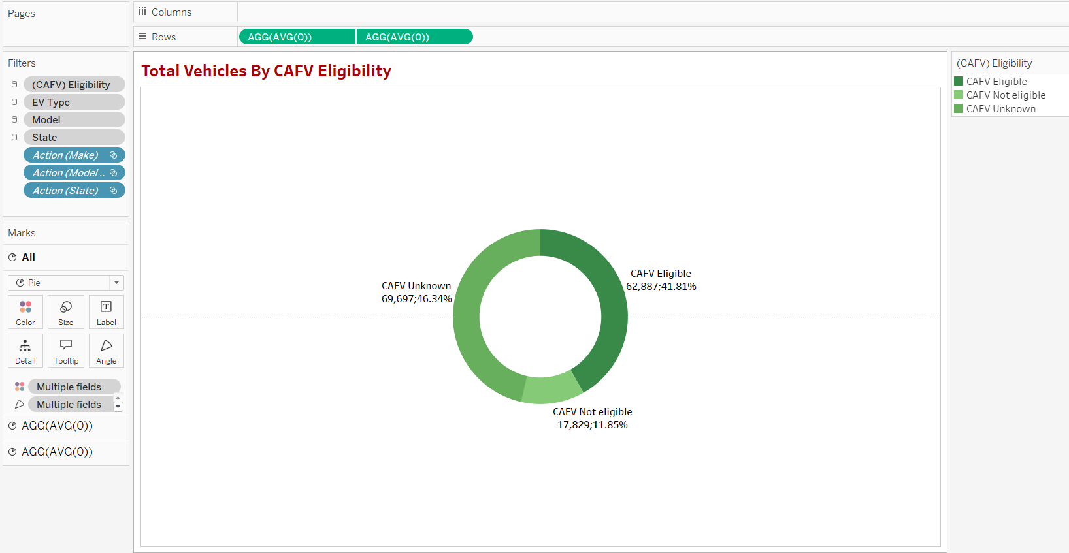
Total Vehicles By CAFV Eligibilty
This graph provides insight into the distribution of electric vehicles based on their eligibility for Clean Alternative Fuel Vehicle (CAFV) incentives, highlighting which vehicles qualify for environmental benefits and tax incentives.

Slide 10
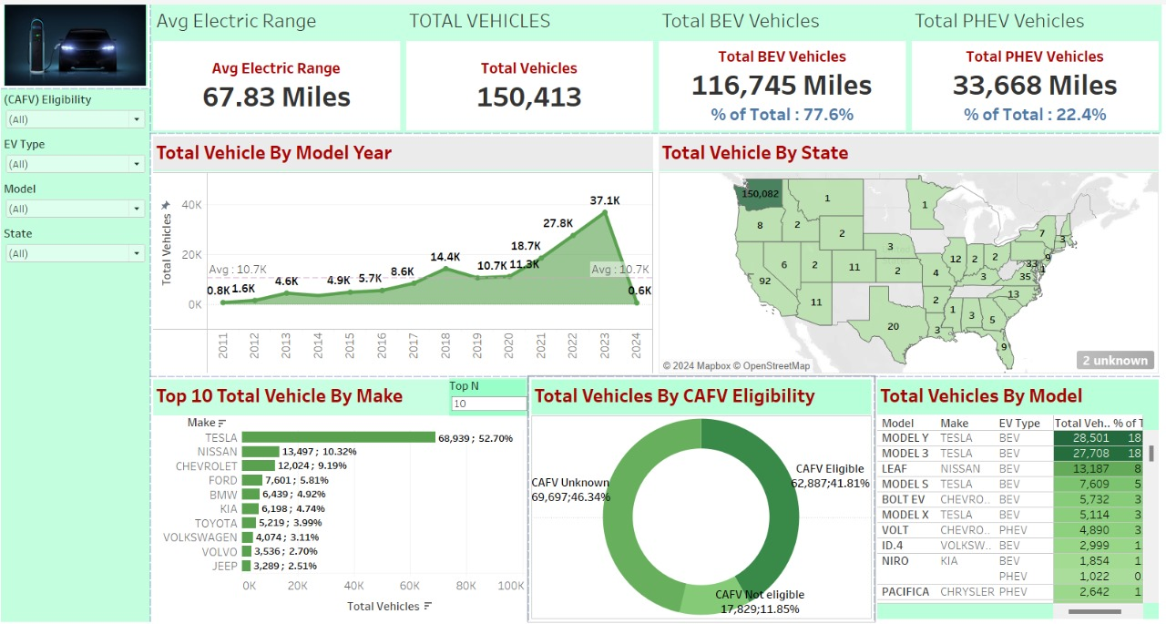
Dashboard Overview:
This dashboard provides a comprehensive overview of electric vehicle statistics, including total miles driven, average electric range, and the distribution of BEV and PHEV vehicles in USA
The dashboard also includes detailed visualizations of total vehicles by model year, state distribution, and CAFV eligibility. Take a look at the growth of electric vehicles over the years and how different states are adopting this technology. The insights into the leading makes and models show the market trends and consumer preferences

Slide 11
Conclusion:
This project highlights significant trends in electric vehicle (EV) adoption across model years, regions, and brands, while also exploring eligibility for Clean Alternative Fuel Vehicle (CAFV) incentives. The findings reveal a strong upward trend in EV registrations in recent years, likely driven by technological improvements and supportive policies. Regionally, certain states lead in adoption due to dense infrastructure and incentives, whereas states with lower adoption indicate opportunities for further development and outreach. Leading brands dominate the market, while emerging brands show potential to diversify consumer options. Most EVs meet CAFV standards, reflecting alignment with environmental goals and regulatory trends. Overall, these insights emphasize the momentum in the EV market and suggest opportunities to expand infrastructure, refine incentive programs, and broaden market options, ultimately supporting a more sustainable transportation future.

Slide 12
THANK YOU

